Slide 1
Business Data Communications & Networking
Chapter 7
Wired and Wireless Local Area Networks

Slide 2
Outline
Why use a LAN?
LAN components
Wired Ethernet
Wireless Ethernet
LAN design
Improving LAN performance
Implications for Management

Slide 3
Why use a LAN?
Information sharing
Improved decision making
May reduce data duplication and inconsistency
Resource sharing
Devices such as printers can be shared by many clients
Software sharing
Some software can be purchased on a per-seat basis and resides on server
Reduces costs, simplifies maintenance and upgrades
Device Management
Software updates and configuration are easier

Slide 4
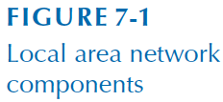
LAN Components
Clients
Servers
Network interface cards (NICs)
Network cables
Hubs / switches / access points
Software

Slide 5
LAN Components
Clients
Devices on the network that request information from servers
Servers
Devices on the network that deliver information or provide services to clients
Network interface cards (NIC)
Also called network cards and network adapters
Operate at layers 1 and 2
Commonly built into motherboards
Ethernet NICs contain unique MAC address

Slide 6
LAN Components
Network Cables
Name | Type | Maximum Data Rate | Used by
Category 3 | UTP | 10 Mbps | 10BASE-T
Category 5 | UTP/STP | 100 Mbps | 100BASE-T
Category 5e | UTP/STP | 1 Gbps | 1000BASE-T
Category 6/6a | UTP/STP | 10Gbps | 10GBASE-T
OM1 (62.5/125 µm) | Fiber | 1-10 Gbps* | 1000BASE-SX
OM3 (50/125 µm) | Fiber | 10-100 Gbps* | 10GBASE-SR
* Speed depends on circuit length

Slide 7
LAN Components
Hubs and switches
Link cables from different devices, sometimes more than one type of cabling
Act as repeaters, reconstructing and strengthening incoming signals

Slide 8
LAN Components
Access points (APs) use radio waves to connect wireless clients to the wired network (instead of connecting using hubs/switches)
Many APs use power over Ethernet (PoE) for electricity
No external power is needed
Power flows over unused twisted pair wires
Also used by some IP cameras and phones

Slide 9
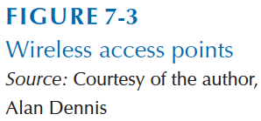
LAN Components

Slide 10
LAN Components
Software
Network Operating System (NOS)
Runs on devices and manage networking functions
E.g., Novel NetWare, Microsoft Windows Server, Linux
E.g., Cisco IOS or JUNOS on routers
Clients devices typically have network software components included with OS installation
E.g., TCP/IP included in Windows, OS X, and Linux
Allows clients to view and access available network resources
Provides directory services about LAN resources
Network profiles specify resources that devices and users can access

Slide 11
Wired Ethernet
IEEE 802.3 standards
Used by nearly all LANs today
Originally developed at Xerox PARC and standardized by a consortium of Digital Equipment Corp., Intel and Xerox (DIX)
Layer 2 protocol, but physical layer must meet protocol requirements

Slide 12
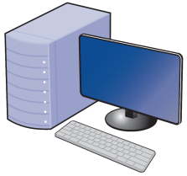
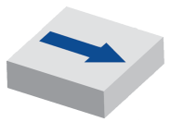
Wired Ethernet
Topology: Basic geographic layout of a network
Types
Logical: How the network works conceptually
Physical: How the network is physically installed

Slide 13
Wired Ethernet
Hub-based Ethernet
Also called shared or traditional Ethernet
Logical bus topology means that all devices receive every frame as if they were connected to the same circuit
The hub is a multiport repeater

Slide 14
Wired Ethernet
Hub-based Ethernet uses physical star topology
Message for C
A
B
Message for C
Message for C
Message for C
Message for C
Message for C
E
C
D

Slide 15
Wired Ethernet
Switch-based Ethernet
Logical star topology means that only the destination receives the frame
Switch reads destination address of the frame and only sends it to the interface (physical port) connected to a circuit
Uses forwarding tables (also called MAC or CAM tables), which are similar to routing tables
Breaks up the collision domain
Physical star topology

Slide 16
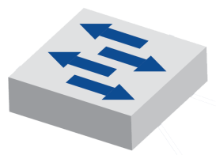
Wired Ethernet
Switch-based Ethernet
Message for C
A
B
Message for C
E
C
D

Slide 17
Wired Ethernet
Switch operation
Switches learn which MAC address is associated with an interface (physical port) by reading the source address on a frame
When a new frame is received, the switch reads the destination MAC address
Looks up destination address in the forwarding table
If found, forwards frame to the corresponding interface
If not found, broadcasts frame to all devices (like a hub)

Slide 18
Wired Ethernet
Switch Forwarding Table
MAC | Port
00-22-69-13-EA-3E | 1
00-22-69-13-EA-3A | 2
00-22-69-13-EA-01 | 3
00-22-69-13-EA-6C | 4
Switch-based Ethernet
A
B
00-22-69-13-EA-3A
00-22-69-13-EA-3E
1
2
4
3
C
D
00-22-69-13-EA-01
00-22-69-13-EA-6C

Slide 19
Wired Ethernet
Switching modes
Store and forward switching – frames retransmitted after entire frame is received and error check is complete
Slower, but fewer errors
Cut-through switching – frames retransmitted as soon as destination address read
Low latency, but some capacity wasted
Fragment-free switching – frames retransmitted once the header (first 64 bytes) is received and has no errors
Compromise between store and forward and cut-through

Slide 20
Wired Ethernet
Media access control
Wired Ethernet uses a contention-based technique called carrier sense multiple access with collision detection (CSMA/CD)
Carrier Sense (CS):
A device “listens” to determine if another computer is transmitting
Only transmit when no other computer is transmitting
Multiple Access (MA):
Many devices have access to transmit on the network medium
Collision Detection (CD):
Collisions occur when multiple devices transmit simultaneously
If a collision is detected, wait a random amount of time and resend
Relies on collision detection rather than avoidance

Slide 21
Wireless Ethernet
Commonly called Wi-Fi
A family of standards developed by IEEE formally called 802.11
Uses radio frequencies to transmit signals through the air (instead of cables)
Wi-Fi has many benefits
Provides network connections where cabling is impossible or undesirable
Allows device and user mobility
Potentially more economical than wired networks

Slide 22
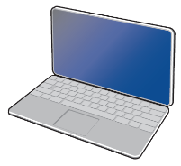
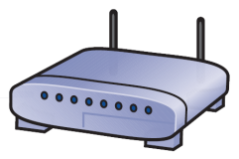
Wireless Ethernet
Components
Access points (APs)
Antenna type
Omnidirectional
Directional
AP ≠ Router
Association with AP
Active vs. passive scanning
Wireless NICs

Slide 23
Wireless Ethernet
Topology
Physical star
Logical bus
Media access control
Uses CSMA/CA (CSMA with collision avoidance)
Two methods
Distributed coordination function (DCF)
Point coordination function (PCF)
Solves hidden node problem
Not widely implemented

Slide 24
Wireless Ethernet
802.11 Frame
Includes four address fields
Two addresses have the same meaning as in wired Ethernet, the others are used communicating with APs and other devices
Frame Control
(2 bytes)
Duration / ID
(2 bytes)
Address 1
(6 bytes)
Address 2
(6 bytes)
Address 3
(6 bytes)
Sequence Control
(2 bytes)
Address 4
(6 bytes)
Data
(46-2312 bytes)
FCS
(6 bytes)

Slide 25
Wireless Ethernet
WiFi devices transmit and receive within frequency ranges
These frequency ranges are divided into “channels”
Frequency ranges (in the United States)
2.4 GHz range
2.412-2.462 Ghz
3 non-overlapping channels
5 GHz range
5.180-5.320 and 5.745-5.825 Ghz
12 non-overlapping channels
Larger frequency range → higher potential bandwidth
Higher frequency → greater attenuation (i.e., shorter range)
Overlapping channels should be minimized

Slide 26
Wireless Ethernet
Types of Wi-Fi:
Type | Date Published | Max Tx Speed | Frequency (Ghz) | Official Status
802.11a | 1999 | 54 Mbps | 5, 3.7 | Obsolete (Superseded)
802.11b | 1999 | 11 Mbps | 2.4 | Obsolete (Superseded)
802.11g | 2003 | 54 Mbps | 2.4 | Obsolete (Superseded)
802.11n | 2009 | 600 Mbps | 2.4/5 | Obsolete (Superseded)*
802.11ac | 2013 | 6.77 Gbps | 5 | Current
802.11ad | 2012 | ~7 Gbps | 2.4, 5, 60 | Current
802.11ax | Est. 2019 | ? | 2.4, 5 | In-Progress
*Still widely used in 2014

Slide 27
Wireless Ethernet
Security
Security is particularly important for WLANs because they are easy to discover
Security protocols
Wired Equivalent Privacy (WEP)
Insecure and easy to bypass
WPA and WPA2 (802.11i)
WPA2 is currently recommended
MAC address filtering
May prevent casual users from connecting

Slide 28
LAN Design
Current best practice is to use wired LANs for primary network and wireless as an overlay network
Select fastest stable technology, cost permitting
e.g., choose 802.11ac over 802.11n or 1000BASE-T over 100BASE-T
Physical WLAN design
More challenging than LANs because of interference
Start with site survey to determine:
Coverage required
Potential sources of interference
Locations of wired hubs/switches and power sources
Number of APs needed

Slide 29
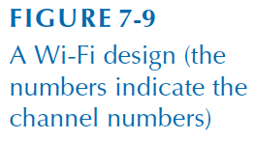
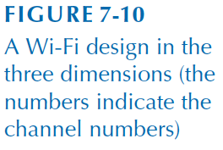
LAN Design

Slide 30
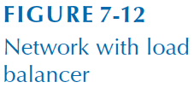
LAN Design
LANs may have very different requirements
Load balancers
Virtualization
Security
SAN

Slide 31
Improving LAN Performance
How can we improve throughput, the total data transmitted in a given period of time?
Identify bottlenecks
The parts of the network restricting data flow
Devices
Servers (check CPU and disk performance)
Clients
Networking devices
Circuits
Demand

Slide 32
Improving LAN Performance
Devices
Upgrade server
Software and hardware (CPU, memory, disks)
Redundant array of inexpensive disks (RAID)
Add a new server
Upgrade clients
Circuits
Buy faster circuit (e.g., 100BASE-T to 1000BASE-T)
Add circuits
Add access points on different channels
Segment network

Slide 33
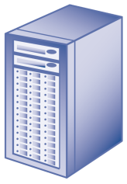
Improving LAN Performance
Network Segmentation
D

Slide 34
Improving LAN Performance
Reducing network demand
Move files to client computers
Encourage off-peak usage
Consider blocking or throttling unnecessary network traffic

Slide 35
Implications for Management
Enterprise LAN equipment is quickly becoming a commodity
SOHO users are primarily moving to wireless
Speeds have increased
Dramatic growth of WiFi-enabled devices
The Internet of Things will influence LAN design

